Slide 1


Real-Time Translation App
State of Art
Supervised By : Dr Amr Ghoniem

Slide 2
Meet the Team
Hazem Ahmed Abd El-Aal
20210265
Abdelwahed Ragab Abdelwahed
20210265
Hamid Walid Fathy
20210273
Abdelrahman Mostafa Hamed
20210531
Hafez Adel Hafez
20210272
Fatma Mohamed Abo ElHagag
20210666

Slide 3
Table of contents
Problem Statement
01
Introduction
02
03
Related Work & Approaches
04
Block Diagram
05
Dataset

Slide 4
Table of contents
06
07
Models Selection
Fine-Tune
09
10
11
Optimization
Proposed Solutions
Future Enhancment
08
Evaluation

Slide 5
01
Introduction

Slide 6
Introduction
In a world increasingly reliant on video content for communication, education, and entertainment, language barriers pose a significant challenge to inclusivity and accessibility.
Millions of non-native speakers struggle to understand foreign-language videos, limiting their access to global media and learning opportunities.

Slide 7
02
Problem Statement
What is the benefit of the project

Slide 8

Problem Overview
Manual Translation and subtitling is time-consuming and often unavailable (Video Editors /Movie Translators)
Language barriers limit access to media content in education, business, and beyond.
With the rise of AI, there is a growing demand for automated video translation.

Slide 9
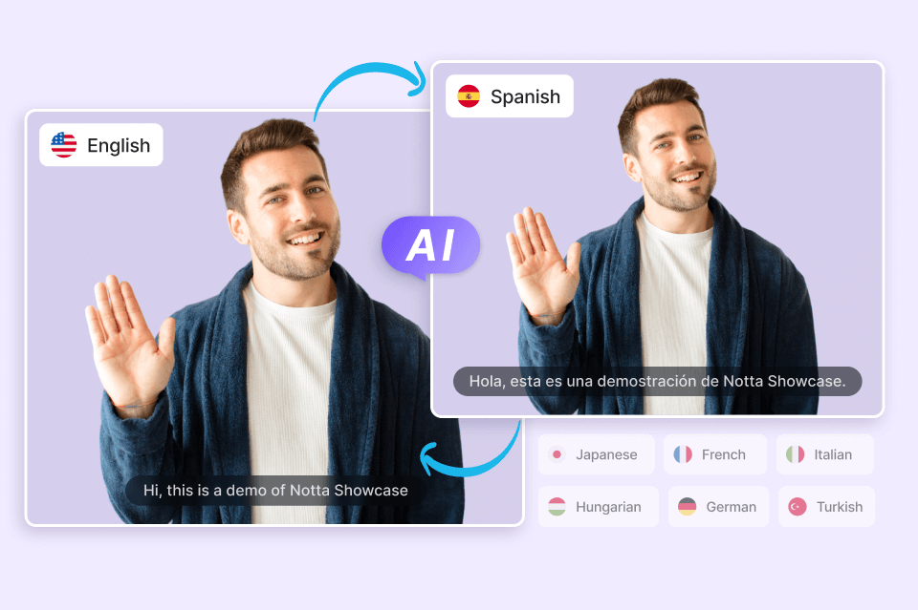
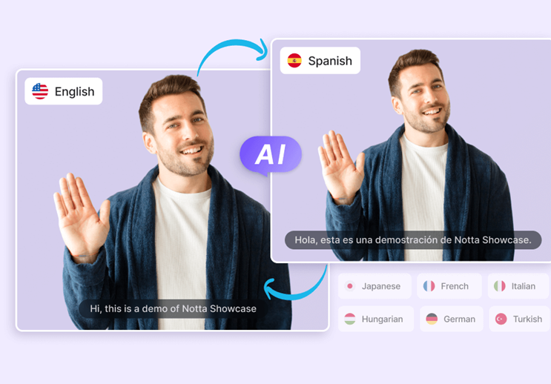
Our Goal
To develop a media player that translates video subtitles making content more accessible to Arabic and English speakers.

Slide 10
Related Work & Approaches
03
Existing tools and technologies in video translation

Slide 11
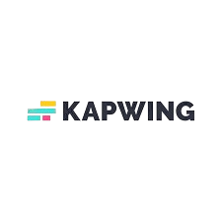




Case study
Youtube
Zoom
Kapwing & VEED
Generates subtitles and translates them after video upload
Real-time captioning in meetings
Subtitle and translation tools for video editors

Slide 12

Case study
Youtube
Zoom
Kapwing & VEED
No real-time support, no subtitle editing
Only works for live conversations, not uploaded videos
No real-time features

Slide 13

What we are missing ?
No unified system for real-time or batch translation
Lack of offline support or open usage (especially in enterprise tools)
No English ↔ Arabic focused solution with a user-friendly GUI

Slide 14

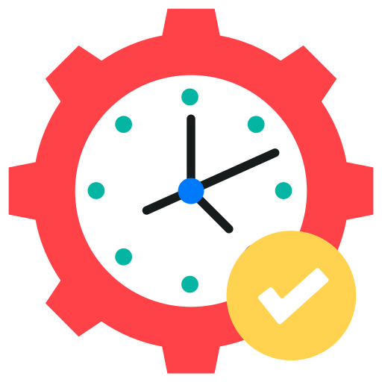

2 Approaches
Real-Time
Batch Processing
Translation happens while the video plays
Fast
Entire video is processed Slow
More accurate (has full context)
Slightly less accurate (partial context)

Slide 15
04
Block Diagram
How the system processes video input from start to finish

Slide 16
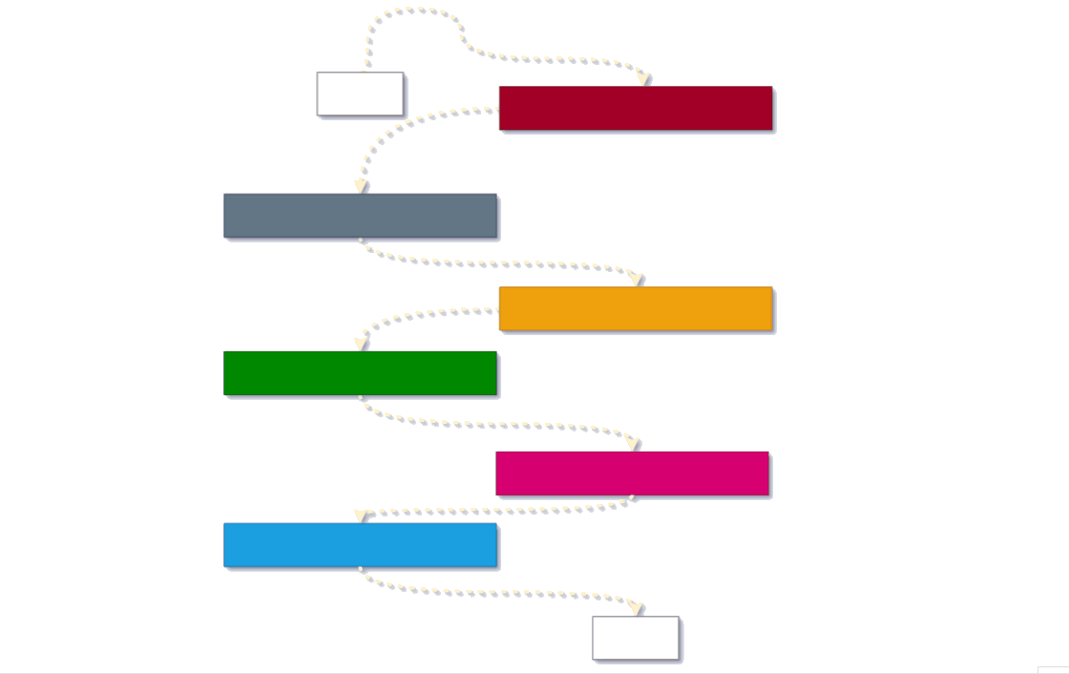
start
Input Video
Extract Audio To Numpy Array
Automatic Speech Recognition
Speech-To-Text
Generate Transcription
Neural Machine Translation
Generate Subtitle For
Translated Language
end

Slide 17

05
Dataset
Text-based dataset supporting machine translation accuracy

Slide 18
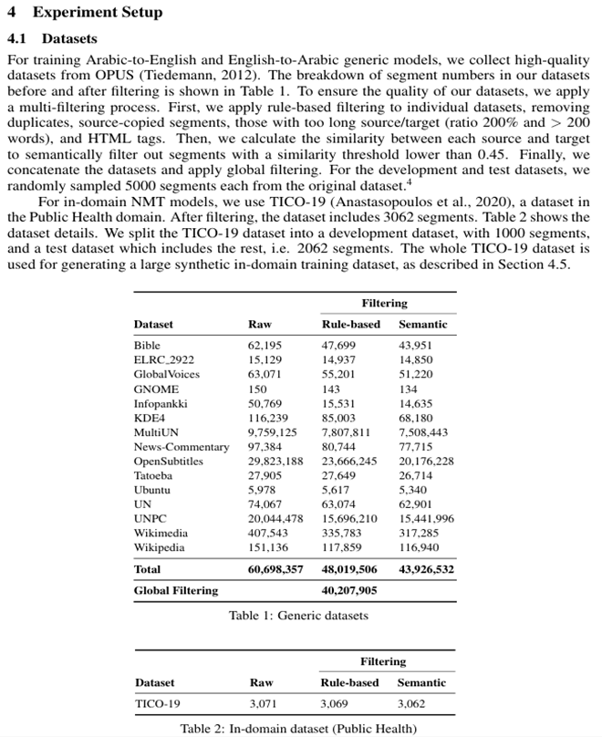
Dataset 40 million sentence
We are using a Global Dataset which is introduced by this paper
cleaned and filtered combination of many publicly available bilingual corpora from the OPUS project, maintained by Jörg Tiedemann from the University of Helsinki.

Slide 19

1.Rule – Based Filtering
The authors started with 60 million sentence pairs and reduced it to 40 million after 3 filtering steps
Sentences where source == target
Sentences with very long lengths or length ratio problems
source and target lengths differ by >200%, or >200 words)
Duplicate sentence pairs
Sentences with HTML tags
better-structured, clean data

Slide 20

2. Semantic Filtering using sentence embeddings:
Kept only pairs where semantic similarity ≥ 0.45
reduces misaligned or incorrect translations

Slide 21
06
Models Selection
What models did we use and why?

Slide 22
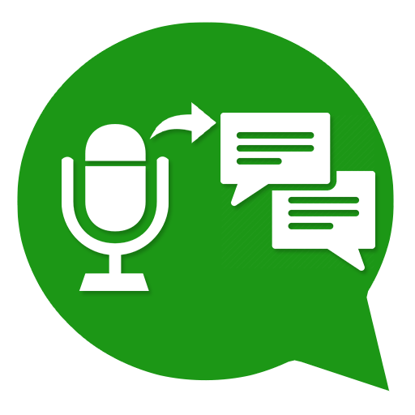
Automatic Speech Recognition Speech-To-Text
Fast -Whisper

Slide 23
Why Whisper
is an open-source, optimized version of OpenAI’s Whisper
Built on CTranslate2, a fast inference engine for Transformer models
4× faster than the original Whisper model, based on benchmark results
Memory-efficient – works well on low-resource devices
Ideal for real-time speech-to-text transcription in our system

Slide 24

Neural Machine Translation

Slide 25

First we must ask several questions ?
Why we didn’t use big models like BERT or Meta’s NLLB?
Should we build a model from scratch or use a pretrained one?
Why we picked MarianMT as our final choice?

Slide 26
Why Use a Pretrained Model?
 | Train From Scratch | Fine-Tune Pretrained
Data Requirement | Very High Maybe more than 10 millions | 100k – 1M is often enough
Compute Power Needed | Very high (multi-GPU clusters, weeks of training) | Low to moderate (1–2 GPUs, a few hours to days)
Performance Quality | Often lower unless massive data and compute available | High, close to or better than state-of-the-art
Training Time | Weeks (depending on model size and resources) | A few hours to a couple of days
Customization | Full control over every layer | Can adjust but not as much as from-scratch models

Slide 27
By using a pre-trained model, we leverage the extensive training and resources already invested by research institutions, allowing us to focus our efforts on fine-tuning and optimizing for our specific real-time video translation task.

Slide 28

Why Not Use Big Models Like BERT or Meta’s Models?
Models like BERT, mBART, NLLB are too big and slow.
They need powerful servers and take time to translate.
Not suitable for real-time use on laptops.

Slide 29
Why We Chose Marian NMT
Lightweight and Fast
Best for Real-Time Translation
Easy to Fine-Tune
Trained on Public Data
⚡
⏱️
It works quickly even on normal devices.
Translates each sentence in less than one second.
🛠️
🗂️
We customized it to give better Arabic translations.
MarianMT was trained on open parallel datasets like OPUS, which are freely available.

Slide 30
About MarianMT (opus-mt-tc-big-en-ar)
Parameters: ~277 Million
Trained on OPUS Data
BLEU Score Accuracy
This is one of the "big" Marian models, offering better accuracy than the standard versions.
Trained by Helsinki-NLP on large public parallel datasets like OpenSubtitles, GNOME, Tatoeba, and more.
Achieves around 20 BLEU on English ↔ Arabic tasks before any fine-tuning or distillation.

Slide 31

⚠️Limitations of the Model – Still Needs Improvement
🎙️Struggles with Informal Speech
The model sometimes fails to handle slang, fast speech, or ASR errors correctly.
🧠BLEU Still Not Great
BLEU score of 20 is decent — but not close to human-level translation.
📦Domain Sensitivity
Performance drops when translating outside the domains it was fine-tuned on.

Slide 32
07
Fine-Tune
Here Comes Fine-Tune🛠️

Slide 33
Fine-Tuning Setup
Base Model
Helsinki-NLP/opus-mt-tc-big-en-ar
A large pretrained model from Hugging Face.
Learning Rate
2e-5
chosen to avoid "catastrophic forgetting," where the model loses its original knowledge
Training Epochs
1
limited by Kaggle compute
Evaluation
5000 steps
Measured every 5000 steps using BLEU and generation length.

Slide 34
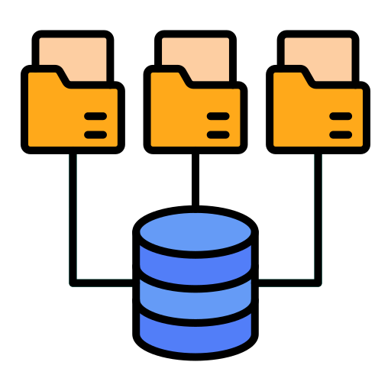
Neulab-TED Talks
🗂️Datasets for Fine-Tuning
🎤
Conversational educational content — good for spoken language.
📚
QED
Instructional videos and subtitles — clearer sentence structure.
🔀
QED + Neulab (Combined)
Merged both for balance between styles.
📑
Cited High-Quality Dataset
Strong performance dataset from research, name undisclosed.

Slide 35
08
Evaluation

Slide 36
📊Evaluation Results On Tatoeba
Dataset Used | BLEU ↑ | chrF ↑ | TER ↓
Base Model | 20.0 | 48.8 | 67.2
Neulab TED | 21.5 | 50.7 | 67.0
QED | 20.7 | 49.1 | 65.7
QED+Neulab | 21.1 | 49.5 | 66.1
Cited Dataset | 23.4 | 50.7 | 62.5

Slide 37
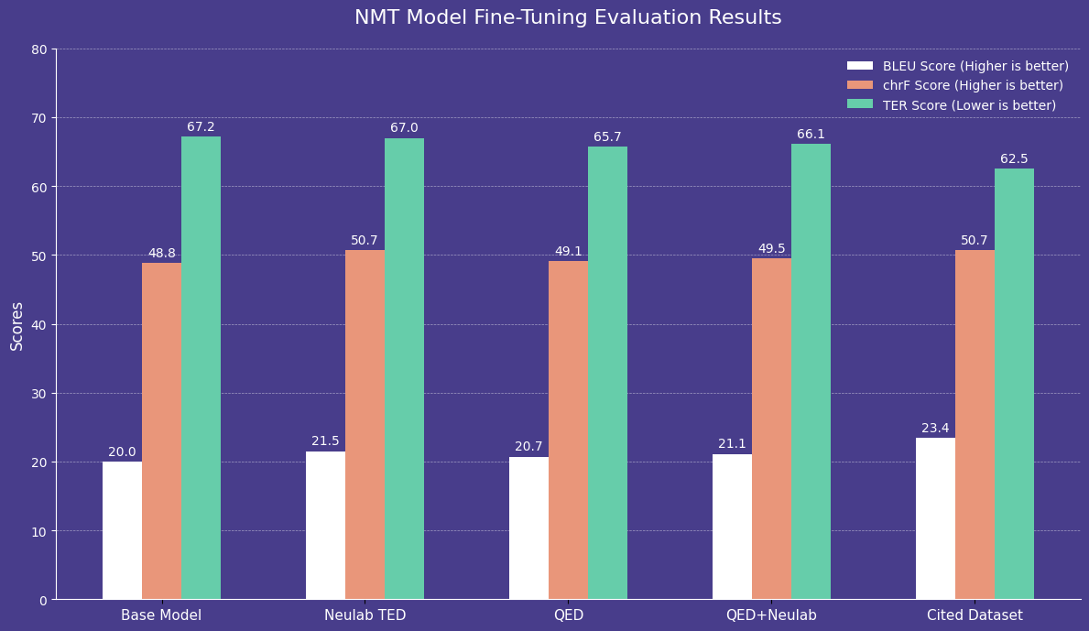
📊Evaluation Results On Tatoeba

Slide 38

📊Evaluation Results On Tatoeba
📈 Best Results: Cited dataset improved BLEU by +3.4 and lowered TER by nearly 5 points.
🗣️ Real Impact: Subtitles became more fluent, clear, and closer to human-quality translation.

Slide 39

But We Need Further Performance!

Slide 40
Model Optimization
09
Quantization
Knowledge Distillation
Pruning

Slide 41
Why Fine-Tuning Wasn’t Enough
⚙️ High Computational Cost
🗂️ Model Still Too Large
📱 Not Suitable for Lightweight Deployment
This is one of the "big" Marian models, offering better accuracy than the standard versions.
Our fine-tuned model uses the Transformer-Big architecture — powerful, but heavy.
It performs well, but it's not practical for mobile apps or web-based usage.

Slide 42
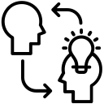
Knowledge Distillation

Slide 43


Model Compression Technique
What Is Knowledge Distillation?
A small "student" model learns from a larger, well-trained "teacher" model.
🤔
How It Works
The teacher generates high-quality outputs (pseudo-labels), and the student trains to mimic them.
⚖️
Balance of Speed and Quality
This process helps create a faster model that keeps most of the teacher’s performance.
👍
Useful for Deployment
Ideal when we need real-time results with limited compute (like phones or browsers).

Slide 44



Distillation in Our System
👨‍🏫 Teacher Model
Fine-tuned Helsinki-NLP/opus-mt-tc-big-en-ar (Transformer-Big)
🧑‍🎓 Student Model
Smaller Helsinki-NLP/opus-mt-en-ar (standard-Transformer)
Generated pseudo-translations using the teacher model
Created a synthetic English–Arabic dataset
Trained the student using Hugging Face’s Seq2SeqTrainer
📦 Training Data
High-quality subset from the original 120M sentence pairs — domain-relevant and clean

Slide 45
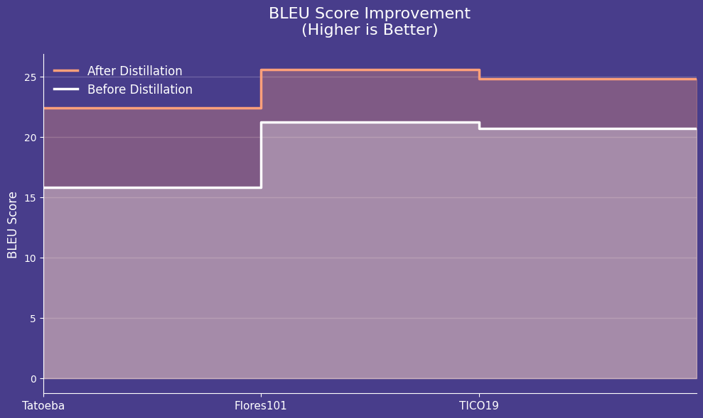
Evaluation – Results After Distillation
🚀 Huge Gains in BLEU Score
+6.6 on Tatoeba, +4.4 on FLORES101, +4.1 on TICO19

Slide 46
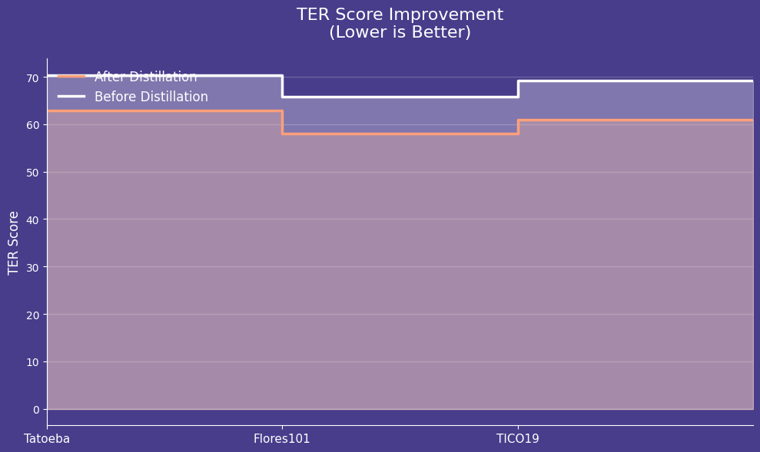
Evaluation – Results After Distillation
📉 Major Reduction in TER
-7.5 (Tatoeba), -7.9 (FLORES), -8.3 (TICO)

Slide 47

Nearly Matches Teacher Performance
⚖️
With just 300MB size, student model performance came close to the 950MB teacher
Ideal for Real-Time Use
✅
The student model is lightweight, fast, and accurate — perfect for deployment in mobile/web video translation.

Slide 48
Proposed Solutions
10
Batch-Processing
Real – Time Processing

Slide 49

Batch-Processing
The Angular-based website processes videos in blocks, transcribing and translating audio segments as a whole, displaying results in a user-friendly interface.

Slide 50



FFMpeg
Fast-API
Extracts audio from the uploaded video
Receives a video file through an API
ngrok
Exposed as an API for public access and testing

Slide 51
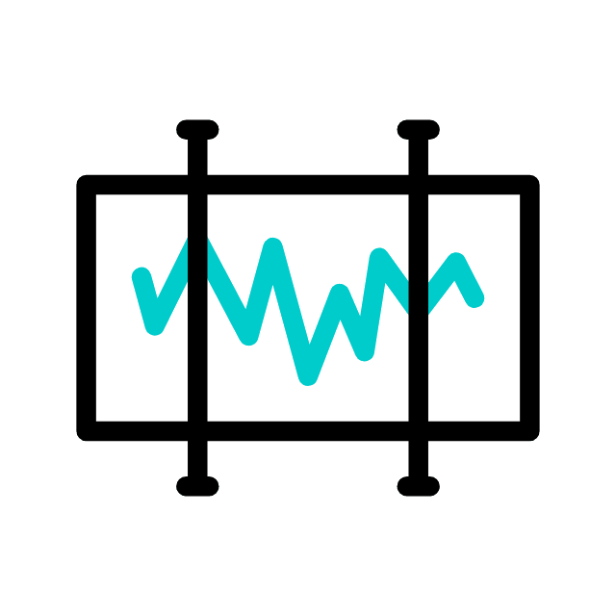
Why FFmpeg
 | Pros | Cons
FFmpeg | Fast, reliable, supports all formats Scriptable via CLI Open-source | Requires CLI knowledge (but great for automation)
MoviePy | simple to use Integrates with other video edits | Slower on large files Depends on FFmpeg internally
pydub | Easy for audio processing Works well with small files | Doesn’t handle video directly — needs audio file input

Slide 52
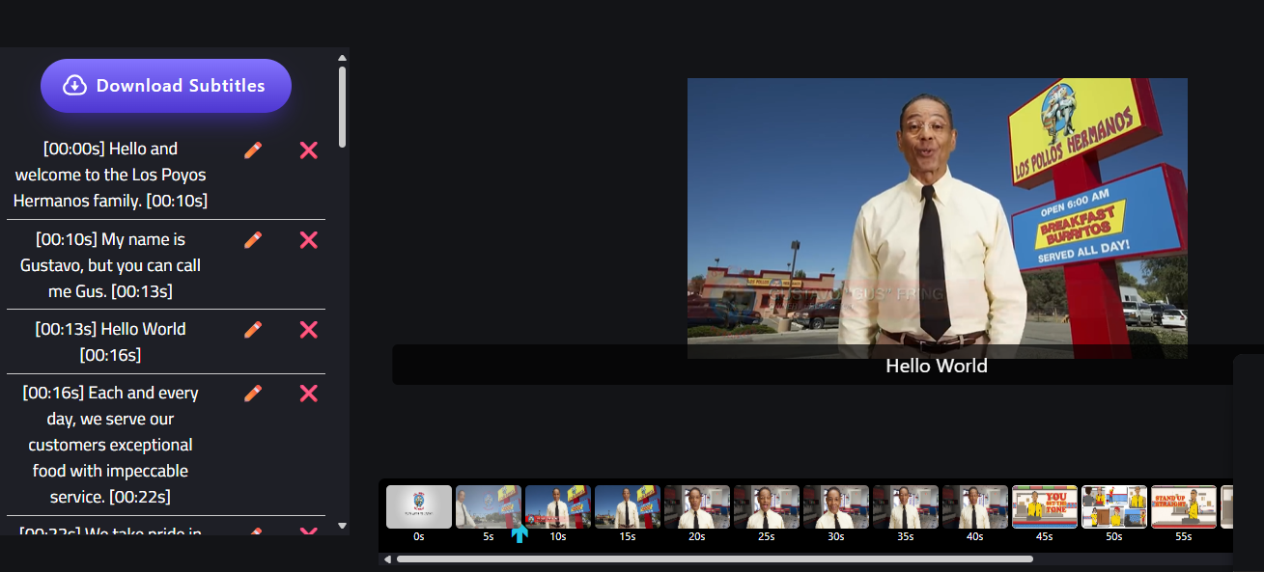
The frontend interacts with the backend transcription API and also runs FFmpeg in the browser using WebAssembly.
This allows users to perform editing tasks fully in the browser — no server required.

Slide 53
Real – Time Aproach

Slide 54


2 Approaches
Queue-Based (Segment Queue)
Overlapping
Cuts the audio stream into sliding chunks
Each audio segment is processed in order, no overlap

Slide 55

Overlapping
Reduces context loss between segments
May result in repeated words due to overlap
Algorithm
Machine Learning Model
Requires logic to merge or de-duplicate results
Slightly slower (extra work on overlaps)

Slide 56




(Segment Queue)
Faster (linear segment processing)
Each audio segment is processed in order, no overlap
Easier to manage, faster, cleaner output
Less processing redundancy, better performance

Slide 57



Overlapping Window vs. Queue-Based Segmentation
 | Overlapping Window | Queue-Based Segmentation
Segmentation | Sliding windows with overlaps | Fixed segments processed sequentially
Context Handling | Preserves more context between segments | May lose context at segment boundaries
Output Quality | Often includes repeated phrases | Cleaner output, no duplication
Processing Speed | Slower due to overlap handling | Faster, less redundant processing
Implementation Complexity | Requires merging, deduplication, and alignment logic | Simpler to implement and debug
Translation Consistency | Slightly better (due to preserved flow) | May be affected by isolated segments

Slide 58


Overlapping
Queue-Based Segmentation
Real-Time Suitability
Less responsive due to buffering/merging
Highly responsive, better for live systems

Slide 59

Segments ?
In our queue-based method, instead of cutting the audio at fixed time intervals
we rely on Whisper’s VAD (Voice Activity Detection) to detect natural pauses.

Slide 60
(Segment Queue)
Queue-Based
Improvement
translation quality
subtitle readability

Slide 61


Improving speed and efficiency
High load, slower response times
Affected system performance, especially during real-time transcription
Used GPU-enabled versions of Faster-Whisper and MarianMT
Achieved significant reduction in processing time
Improved real-time responsiveness and user experience

Slide 62
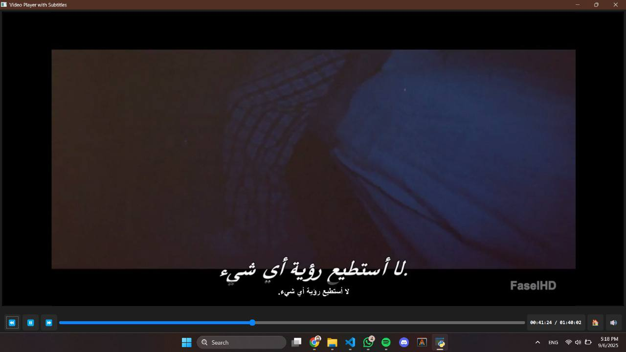
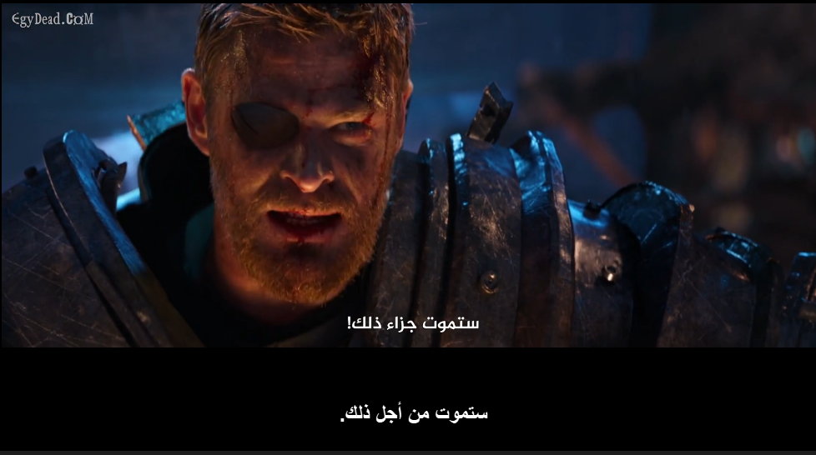

Real-Time Factor (RTF) ~0.159
Average Processing Time | 20 Minutes per 2-hour video

Slide 63
11
Future Work

Slide 64

Future Work
01
Multilingual subtitle translation
02
Language detection and automatic pipeline routing
03
Support for real-time dubbing
04
Native mobile support

Slide 65
Resources
Guo, J., Tan, X., He, D., Qin, T., Xu, L., & Liu, T.-Y. (2018). Non-autoregressive neural machine translation with enhanced decoder input.
Roy, A., Ray, P., Maheshwari, A., Sarkar, S., & Goyal, P. (2024). Enhancing Low-Resource NMT with a Multilingual Encoder and Knowledge Distillation: A Case Study.
Yi Ren, Jinglin Liu, Xu Tan, Chen Zhang, Tao Qin, Zhou Zhao, Tie-Yan Liu. (2020). Sim ulSpeech: End-to-End Simultaneous Speech to Text Translation.
Xi Chen, Songyang Zhang, Qibing Bai, Kai Chen, Satoshi Nakamura. (2024). LLaST: Im proved End-to-end Speech Translation System Leveraged by Large Language Models.
Mª Azahara Veroz-González, Mª Pilar Castillo Bernal. (2024). Automatic closed captions and subtitles in academic video presentations.
Bandhav Veluri, Justin Chan, Malek Itani, Tuochao Chen, Takuya Yoshioka, Shyamnath Gollakota.(2023). Real-Time Target Sound Extraction.
Yoon Kim, Alexander M. Rush. (2016). Sequence-Level Knowledge Distillation
Yasmin Moslem, Rejwanul Haque, John Kelleher, Andy Way (2022). Domain-Specific Text Generation for Machine Translation

Slide 66

Thanks

